Slide 1
Feature: new agent – Maintainer
Flies over field, charges up and collects
berries from picker bots.
Replaces need to return to base , hence picker
bots will have to traverse much less distance
to reach next bush.
Picker bots will now enter state of sleep
after picking up a berry until a new target location is transmitted to them.
In this state they do not move nor consume energy.
Picker bots will send their location to a Maintainer and enter sleep state if their storage is full, or they are low on power

Slide 2
New Feature: Picker bots’ work optimization
Agents will now try to efficiently distribute their work by looking if it will take less steps for other pickers to reach their destination. If at least one agent benefits and the other does not lose they will exchange their targets.
Such communication allows agents to not waste time and powers just because there were no other free pickers available at the time of locating ripe bush by scout agent.

Slide 3
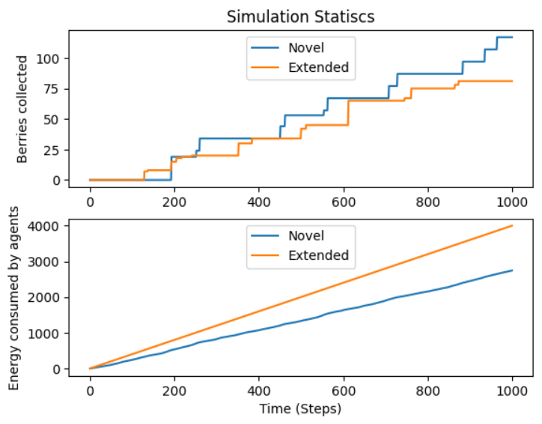
As shown on diagrams, implementation of new features allows agents to collect more berries over same period of time and do it more efficiently by consuming less power

